Slide 1
Explore It! Foundations

Slide 2
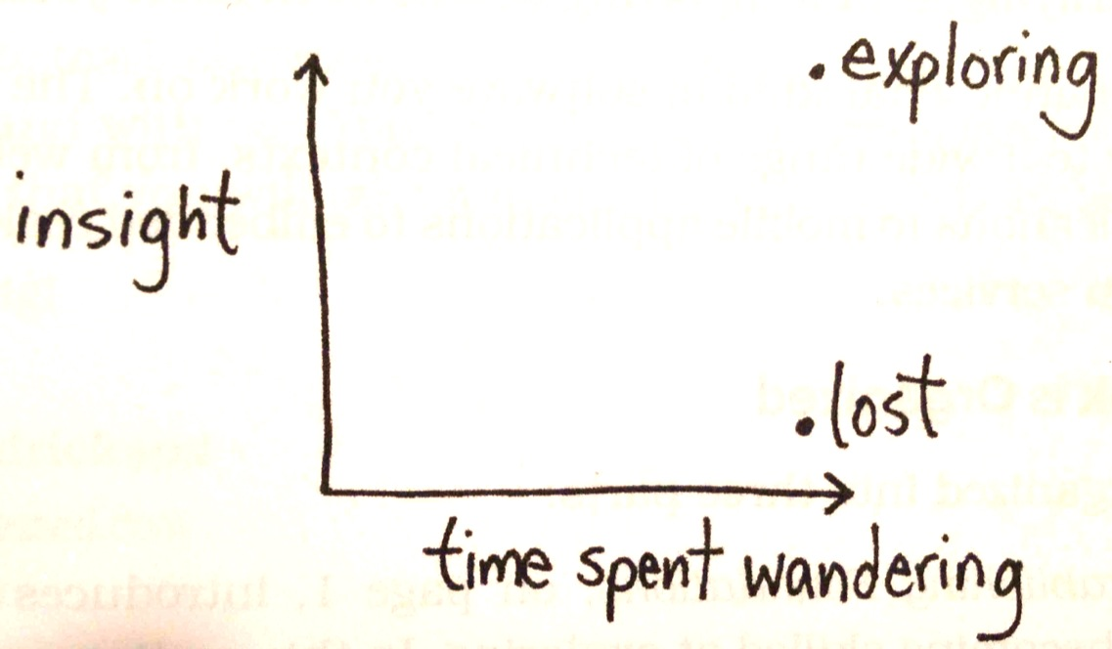
On Testing & Exploration
What does this chart mean?
How could this apply to testing?

Slide 3
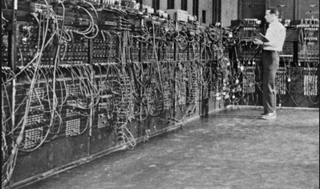
The ENIAC problem
ENIAC is mostly wires
Mice like wires
How would you choose the wires?

Slide 4
The ENIAC Team Solution
Starve some mice
Offer them various types of wire
Choose the wire that the mice didn’t like even when starved

Slide 5
Abstracting from the ENIAC solution
Recognize a risk
Turn the risk into a research question
Don’t speculate, design an experiment
Gather empirical evidence
Use the results to inform your actions

Slide 6
Different questions – different tests
How will the system hold up under peak load?
Run a performance test
Does the method do what is intended?
Run some unit tests
Can the user navigate to a feature?
Run a usability test

Slide 7
Not enough time
Comprehensive tests may take to long to write and execute
An alternative strategy
Does it work as expected under known conditions?
Use standard testing approaches
Are there any other risks?
Use exploratory testing

Slide 8
Checking versus exploring
Checking
Fine grained tests provides broad coverage
Validate behavior under expected conditions
Exploring
Identify risky areas
Design some experiments to explore with
Neither is sufficient independent of the other
Tested = Checked + Explored

Slide 9
Exploratory Testing
Simultaneously
Designing
Executing
Learning
Using insight
Gained from previous experiments

Slide 10
Immediate execution
Key distinguishing feature
As soon as you think of an exploratory test
You execute it
Use the feedback to guide future tests

Slide 11
Time boxing
Set a time limit for your exploration
Without time boundaries you could wander indefinitely (aka, get lost)
Helps you focus and prioritize your options
Take notes
Jot down observations
Use these to inform future sessions
Use them to debrief stakeholders
They ARE NOT formal bug reports

Slide 12
Consider early explorers
Columbus
Sir Edmund Hillary (Everest)
Lewis and Clark
We face a common situation
Surprises
We use tools – what is the most important?
Sometimes it is fun, sometimes drudgery and sometimes fraught with danger
If the map and the territory differ – trust the territory!

Slide 13
A charter guides exploration
Lewis and Clark had a specific charter from President Jefferson
Target – the Missouri river and adjoining water ways leading to the Pacific
Seek information – a trading route to the pacific; people and culture; fauna and flora
Use resources – boats, tents, guns and ammo, trading items, etc.

Slide 14
Charter - a simple template
Explore <target> with <resources> to discover <information>

Slide 15
<target>
Where are you exploring?
A feature
A requirement
A class

Slide 16
<resources>
What resources will you have available?
A tool (JUnit, JUnitParams, Fit, etc)
A technique (Boundary, Structure, Data Flow)
A data set
Interdependent features

Slide 17
<information>
What are you hoping to find?
Security info
Performance info
Reliability
Usability
Conformance to spec
Defects

Slide 18
Example charter - security
Explore editing profiles with injection attacks to discover security vulnerabilities
Vary the injection attack – sql injection, javascript injection

Slide 19
Example charter - feature
Explore editing profiles with various login methods to discover surprises
Vary the login method: use your twitter account, Facebook account or Google account to see if the system responds as expected with each authentication method

Slide 20
Bad charter – too specific
Explore editing last name with the value O’Malley to discover if the profile edit feature can handle names with apostrophes
Reads like an actual test case – too narrowly defined to exploratory

Slide 21
Bad charter – too broad
Explore system security with all the hacking programs you can find to discover any security holes
Like saying – make a map of the universe!

Slide 22
Sources for good charters
Requirements
Discussions where the answers are vague or contain uncertainty
Interactions between new features and existing capabilities
Read the code and the comments // I don’t now why this works – don’t touch it!

Slide 23
Characteristics of a good charter
The target and information are deemed valuable by the stakeholders
Specific enough to provide guidance
General enough to encourage exploration and variation

Slide 24
Sources – your worst nightmare
Imagine a disaster scenario caused by your system and work backwards to charters
Set the stage
Gather headlines
Choose a big risk related to a headline
Brainstorm contributing causes
Refine causes to charters

Slide 25
Example nightmare
Setting
Getting up in the morning, glancing at the news
Headline
Shopping cart exposes credit card info to hackers
Man surprised by delivery of 827 garden gnomes, “I only ordered 1”
Chose a big risk to work on
Surprise gnome delivery
Brainstorm contributing causes
Invalid input
Hitting refresh or browser back and forward button
Clicking submit multiple times
Integration issue between web and warehouse systems
Refine causes into charters
Explore purchasing flow with refresh, back & forward buttons, multiple submits to discover ways to mess up order quantity

Slide 26
Interesting variations
Variables: an exploratory testing perspective
Anything you can change directly
Anything you can cause to change indirectly

Slide 27
Potential variables
On a GUI – Any navigational element or any control (button, link, text, dropdown, etc.)
Subtle variables
Consider URL parameters
Modify browser cookies manually
Configuration files
System settings

Slide 28
Variable categories - counting
Zero, one or many heuristic
0 record found; 1 records found
Too many heuristic
Try overloading the system (big file, to many selected options, extra parameters, …)
Too few heuristic
Chess Wars game (when no friends had the app)
An order with nothing selected
Not enough digits (phone num, zip code, etc)

Slide 29
Variable categories – relative position
Beginning, middle and end heuristic
Try operations on the first item
Try operations on the last item
Try operations on the middle items
Check for sorting issues
Notice how numbers sort differently than alphabetical characters
See Excel Sorting example

Slide 30
Variable categories - files
Choose an alternate install location
Choose a network drive to install or locate a resource
Try accessing from home (off the work network)
Try access at work (on the work network behind a firewall)
Try on Windows, Linux and Mac
Try on a full hard disk

Slide 31
Variable categories - Geography
Try international zip codes
Try different time zones
Try international phone numbers

Slide 32
Variable categories - formats
Try international date formats
Try military and AM/PM time formats
Try international phone number formats
Try various email formats
My grad school email is tim@cs.clemson.edu this is not accepted on some applications because of the double dot in the domain

Slide 33
Variable categories - depth
Anything that supports nesting can be tested with a high degree of nesting
Xml files with deeply nested elements
HTML files with nested tables or other elements
Arithmetic expressions with parenthesis
See Excel’s error with parenthesis

Slide 34
Summary of heuristics
Counting – zero, one or many
Selecting – some, none or all
Positioning – beginning, middle & end
Formatting – violate the norm
Nesting – go deep
Configuring – manipulate hidden settings

Slide 35
Exercise (solo or with partner)
Write down an application (either real world or one you can imagine)
Create three different charters for exploratory testing against the application
Write down three exploratory testing strategies for each charter
Turn in your results for some extra credit

Slide 36
Evaluating Results
Since exploring is “going where no tester has gone before”
And since exploring is looking for surprises
How do we evaluate the results?

Slide 37
Exploratory results evaluation
Assessing correctness involves a subjective judgment call or specialized knowledge
Suppose you are exploring a rich internet application. Is it okay that you can’t add a page to your favorites?
You are doing evil things to the system. Turning off the network in the middle of a transaction, canceling in the middle of a process. Is it okay that the system recovers gracefully from some items but not others?
A team of PhD scientists develop a program to perform a sophisticated calculation. You input some values a number is displayed. Is it right or wrong?

Slide 38
What we need
Intransigent rules
Alternative resources
Approximations

Slide 39
Never or Always
A set of rules that no matter what they can’t be broken
Can you think of some apps and some associated “never/always” rules?

Slide 40
Some sources for always/never
Requirements – core capabilities
Non-functional requirements – Qualities
Risks

Slide 41
Core capabilities
Requirements document
Discussion with stakeholders
Who will use the system
What is their purpose
What are the alternatives to the system
If nothing else worked, what must work

Slide 42
Quality Factors
Non-functional
Accuracy
Reliability
Availability
Usability
Security

Slide 43
Risks
Medical – the system can never hurt someone
Game – the system can never be boring
Financial – the system can never create or destroy money

Slide 44
Alternative resources
Internal consistency
Require the same information regardless of the screen where requested
Same calculation two different ways or locations give the same result
Fonts, colors, metaphors, nav elements

Slide 45
Standards
Always check with the stakeholders to make sure standards are applicable to the system
Healthcare software must conform to HIPAA (Health Insurance and Accountability Act of 1996)
Corporate finance systems must conform to the Sarbanes-Oxley law
GUIs should conform to the underlying OS guidelines
Protocol based software should conform to published standards from IEEE or other applicable standards bodies

Slide 46
Comparables
Pretty simple
Find something similar and compare to the app you are exploring
Competitor
Open source
Older version
Beta version

Slide 47
The airspeed of a bird
You are in an interview for a software test position and the question is asked
Our special ornithological velocity software is computing the speed for an African Swallow
Inputs are weight, age, wingspan and altitude
How do you proceed?

Slide 48
Some approximations
Try zero for every input value
What if the system outputs a negative value for the velocity?
Worse, what if outputs a number like 12.8 Meters/Second
Now what?

Slide 49
Google/Wikipedia to the rescue!
Find some general info on swallows
Convert to the same units
Compare to our results – are they reasonable?

Slide 50
Approximation techniques
Evaluate against a range
Evaluate characteristics
You are testing a random number generator that is supposed to generate values between 0 and 9. How do you test it?
Invert the result.
How do you test a square root function?
How do you test a routing algorithm?

Slide 51
Mad lib testing (nouns & verbs)
Make list of things in the application
Make a list of actions in the application
Now randomly mix them
Use these as your instructions to get unique and likely untested execution sequences

Slide 52
Driving without a GPS - navigation
Don’t stay in the same rut
Make lists of every way to navigate to a location
Make lists of every way to leave a location
Try all these and be on the look out for more
Sources
GUI elements (buttons, lists, text fields, labels)
Window elements (minimize, max, close)
Links (text and graphic)
Keyboard shortcuts
Browser back, forward, refresh, history, favorites, tampered with URL parameters

Slide 53
Personas
Describe detailed person types that will likely be using your system
Not just things like “a techy guy”
Pradeep, 34 year old, Microsoft Certified Professional
Jim, 83 year old, first time computer user
Suppose you are testing Turbo Tax, what different testing explorations might the two personas above drive?

